Slide 1
CSCI 4110 Animation Basic Principles
Mark Green
Faculty of Science
UOIT

Slide 2
Introduction
All film and video is an illusion
There are no moving objects, just a sequence of still images
They rely on our ability to interpret a sequence of still images shown rapidly as motion, our brain reconstructs the motion
This has been known for several centuries and serious experimentation with this started in the mid 1800s
Movies as we know them first appeared when we figured out how to record pictures on celluloid

Slide 3
Introduction
Early movie camera were all mechanical, the operator had to crank the camera at precisely two cranks per second to properly record the motion
Early projectors were largely mechanical, but included a motor to advance the film
By the 1920s the technology of film recording was largely perfected and has changed little since then
First animations appeared in the early 1900s
Good source: E.G. Lutz, Animated Cartoons: How they are made, their origin and development, 1920,

Slide 4
Introduction
How many images per second do we need?
The still images in a film are called frames, so this is usually expressed as frames/second or fps
There is no one answer to this question
It depends on the brightness of the image, the brightness of the room, the subject matter, etc.
Acceptable fps is lower in a dark room, this is why movie theatres are dark
35mm film has 24 unique frames per second, each frame is shown twice, giving an effective rate of 48 fps

Slide 5
Introduction
Trivia: early film was 16 fps, each frame was shown 3 times
NTSC analogue TV worked at 30 fps, which was divided into two fields, which effectively gave 60 fps
For Siggraph film show you needed to render on fields not on frames, one of the few venues that demanded this
Most digital video standards keep 60fps, but use progressive scan which eliminates fields
For computer monitors we like to have 60 to 72 fps, at the hardware level

Slide 6
Introduction
But do we need 60 unique images per second for video? No
Saturday morning cartoons are 12 fps, that is usually viewed as the absolute minimum
For interactive applications 10 fps is the minimum
Little real improvement beyond 30 fps
Note: a software fps higher than the hardware fps is useless, it can’t be displayed, regardless of what some tech journalists think

Slide 7
Classical Animation
There is a wide range of classical animation techniques
Any technique where you can record one frame at a time can be used
Easiest is stop frame animation, done with physical objects or characters
Pose the object, take a frame, move the objects slightly, take a frame, etc.
No specialized hardware or software is required, just a bit of patience

Slide 8

Classical Animation

Slide 9
Classical Animation
Animations have been produced using sand and nail boards or pinscreens
The NFB has many examples of these techniques, Canada a leader in the development of animation
Disney perfected the classical cel based animation style, though most of the techniques were known before
They just hadn’t been put together and done on a large scale before Disney, first feature length animation film

Slide 10
Sand and Pinscreen Animation
https://www.nfb.ca/film/sand_castle/
https://www.nfb.ca/film/mindscape/

Slide 11
Classical Animation
Team based approach
Lead animator would draw the “key” frames, the frames that were important for the motion
This would just be an outline, it would not be a fully coloured in figure
The assistant animators would fill in the motion, the frames in between, became known as “tweeners”, this is still an outline
A pencil test is to flip through the images to see if the motion looks right
There could be separate animations for each of the characters that appear in the final frame

Slide 12
Classical Animation
The pictures were then photocopied onto plastic sheets called cels, for celluloid
These sheets would then be given to painters who would add the colour
Paint on the back of the sheets, outline will hide small mistakes
At the same time background artists would be drawing the background, a much larger image done with more care
Backgrounds used in many frames, so can spend more time on them

Slide 13
Classical Animation
Final step was filming, animation camera or animation stand used for this
The layers of the animation were assembled, first the background, a solid image
Then the cels for the characters were placed on top, most of the cel is transparent, background will show through
Once all the characters have been placed a single frame is recorded
An animation stand has multiple levels, so the characters can easily be manipulated individually

Slide 14
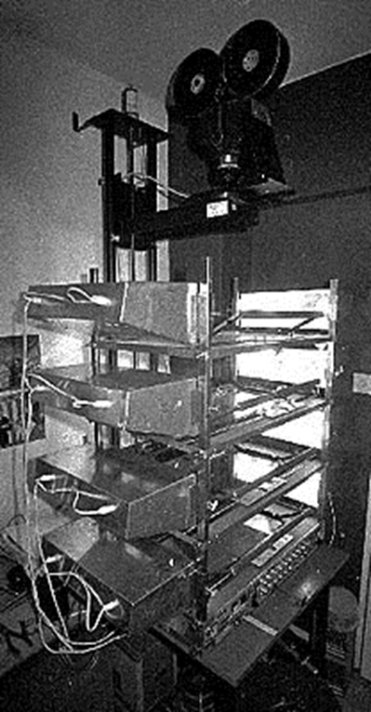
Classical Animation

Slide 15
Classical Animation
Key production technique: library of standard motions, once the cels for a standard motion, for example a character running have been produced they are saved and used over again
Saturday morning cartoons, long sequence of characters running, cheap and quick to produce
Typical studio project will have a team of around 30 people
One or two lead animators, 5 or 6 assistant animators, one camera operator, one or two background artists and the rest are painters

Slide 16
Classical Animation
People would start as painters and work their way up to animator, usually took 25 to 30 years
This approach is rarely used now, it is far too expensive
Computer animation has replaced hand animation in commercial production
There are still independent animators that do hand animation, but not for commercial products

Slide 17
Computer Animation
Computer animation started in the 1960s, largely viewed as an academic curiosity
Results were typically of low quality and not very interesting
Two things happened that changed all of this
NRC working with NFB produced one of the first computer based keyframe animation system
Show that this was possible, won a technical Oscar for this work
Peter Foldes used this system to produce “Hunger”, which was nominated for an Oscar

Slide 18
Hunger
http://www.nfb.ca/film/Hunger/
http://www.nfb.ca/film/Hunger/

Slide 19
Computer Animation
The other key event occurred at NYIT, where they started to assemble a group of computer graphics researchers to produce computer animation software in the late 1970s
They produced quality animations, that were impressive and really started the industry going
Did more keyframe animation software and some early 3D animation software
Some of the techniques are still used today
This started the first generation of computer animation companies

Slide 20
Computer Animation
First generation companies produced their own software, used large expensive computers and had a large staff
These companies where successful for about 5 or 6 years, there was about a dozen of them
Technology revolution started occurring around the end of the 1980s
Silicon Graphics workstations became quite powerful, could challenge the mainframe computers used by first generation companies at a much lower price point

Slide 21
Early Computer Animation - 1984
https://www.youtube.com/watch?v=xCObCXdoFTc
https://www.youtube.com/watch?v=eedXpclrKCc
Information International Inc. 1982 demo real:
https://www.youtube.com/watch?v=ADF3-6owY0A
Robert Abel and Associates 1982 demo real:
https://www.youtube.com/watch?v=cT3_3d2JcR0

Slide 22
Computer Animation
Companies like Alias started producing commercial 3D animation software
Could now get into the business for around $100,000 and two or three people
These companies could outbid the large studios for TV commercials, the main source of income for many of the first generation companies
Over a one or two year period all but two or three of the first generation companies went bankrupt
The ones remaining had concentrated on film and special effects that the smaller companies couldn’t handle

Slide 23
Computer Animation
Now the computer animation software industry has largely consolidated into one large company AutoDesk and a number of smaller ones
Silicon Graphics is gone, replaced by PCs
Pixar: got into the animation business by mistake
Founded by George Lucas to build hardware for the film industry, they started building very high end graphics computers
It was later bought by Steve Jobs when he left Apple
They started doing animations to sell the hardware

Slide 24
Computer Animation
Had access to very good creative people through Lucas Film, so could do some very good work
They started producing their own animation software to make their demos easier
Soon discovered that they could make more money producing animations and animation software, so the hardware side of the business was dropped and the rest is history

Slide 25
Theory
For animation we need to have something that changes over time, so our models must have time dependent properties
These properties could be the shape or geometry of the object, or they could be its colour or some other aspect of its visual appearance
We say that our model M is a function of a set of animation variables, variables that change over time:
M(a_{1.} a₂, a_{3,} … a_{n})
Where the a_{i} are the animation variables

Slide 26
Theory
The animation variables themselves are some function of time
There are many different functions that we could use depending upon the nature of the motion
One approach is to specify a number of key values at particular points in time, then some interpolation scheme is used to determine the values in between
This could be a linear function, but there are problems with this, at the key frames the velocity isn’t continuous, which produces a jerky motion

Slide 27
Theory
There are several ways to avoid this problem
One is to fit a smooth curve to the key frame values
Another approach is to use ease-in and ease-out, where the velocity is zero at each key frame and the motion accelerates out and decelerates into a key frame
These schemes work okay for a position, but don’t work very well for an angle
For angles we need to use quaternions and interpolate the quaternions
This guarantees a smooth interpolation, with a minimal amount of work

Slide 28
Theory
The animation variables could be the result of some type of computation
This could be a dynamics computation where we consider the physics of the object’s motion
It could involve inverse kinematics if we are using bones or skeletons for animation
This is where life can get a bit more complicated due to the mathematics involved

Slide 29
Early Techniques
One of the earliest techniques was the P-curve
The simplest way to view a P-curve is as the position of an object over time
The animator draws the P-curve that gives both the position and dynamics of the motion
Where the curve is drawn quickly the object moves quickly and where it is drawn slowly the object moves slowly
This can be done by sampling the curve, as it is drawn, at equal time intervals
This will result in a dense set of points where the motion is slow, and a sparse set where it is fast

Slide 30
Early Techniques
To produce the animation we move down the curve position the object at each point, for the next frame we move to the next point
This mimics the dynamics of the curve drawing, the object will move slow where the points are dense and fast where they are sparse
A more realistic motion can be achieved by rotating the object so it lies along the curve tangent
P-curves can be used for any animation variable, it is not restricted to position

Slide 31
Early Techniques
A number of early systems tried to mimic the classical key framing technique
The animator would draw two key frames and then the computer would interpolate them to produce the frames in between
While this sounds simple, it turns out to be a very hard problem, unless we impose some constraints
If the animator can draw whatever they like for the two key frames we have the problem of matching up the points in the two sketches so we can interpolate them

Slide 32
Early Techniques
First we have to assume that new features aren’t introduced between the key frames, that is there are corresponding points in the two sketches
Each sketch will be made up of a number of strokes, we want to have the same number of strokes in each sketch
The first step is to match up the strokes, find equivalent pairs of strokes in the two sketches
Some systems forced the animator to always draw the strokes in the same order, so it is easy to match them up, otherwise the problem becomes quite difficult

Slide 33
Early Techniques
Once we have pairs of strokes, we parameterize the strokes based on their curve length, we can then sample both strokes at evenly space parameter values to produce the corresponding points
Now we are ready to interpolate the points using any of the technique described earlier
If we introduce a new feature at a key frame, we need to mark it as a new feature so the system doesn’t try to match it in the previous key frame

Slide 34
Early Techniques
A number of successful key frame systems were produced, include the NRC system
They were not the easiest to use and did produce surprising motion which the animator needed to control by introducing new key frames
These systems lead to key parameter and key pose systems that are used today

Slide 35
Key Based Techniques
The key pose technique is based on posing the character at the key frames
The transformation matrices connecting the different parts of the character are manipulated to produce the desired pose
For most characters this only involves a rotation, but scale and translation are also possible
The in between frames are generated by interpolating the transformation matrices and then generating the character position

Slide 36
Key Based Techniques
Usually the rotations are pulled out the matrix and interpolated separately to give better motion
Inverse kinematics can be used for find some of the matrices, the animator positions the end of a limb and the matrices for the other parts of the limb are automatically computed
Forward kinematics is what we normally used in hierarchical modeling
We multiply the matrices from the root of the model to the leaves to produce the position and orientation of the objects at the leaves

Slide 37
Key Based Techniques
Forward kinematics are easy to do, just a matrix multiply
The inverse problem is more difficult, we have positioned the object at the leaf and now we need to compute the matrices from the root to the leaf to match the position
Problem: there isn’t a unique solution, there can be no solution, one solution or many solutions
In the case of many solutions, some of them will be very unnatural, usually associate an energy penalty with the solution, avoid positions that are difficult

Slide 38
Key Based Techniques
There are a number of inverse kinematic algorithms, books on computer animation will usually have several
Some of the inverse kinematic algorithms suggest animation paths as well
A key parameter system keys the animation variables that control the shape and appearance of the object
Can adjust parameters while viewing the model to define a set of keys, typically several parameters are specified at the same time

Slide 39
Key Based Techniques
The animator presses a button to save the parameter values and then goes to the next key
The parameter values are then interpolated between the sets of key values
Can produce custom interfaces for all of the objects in the model, easier for the animator to use
Can even combine the interfaces for several objects to produce synchronized motion
Can either be produced manually, or as part of the animation system

Slide 40
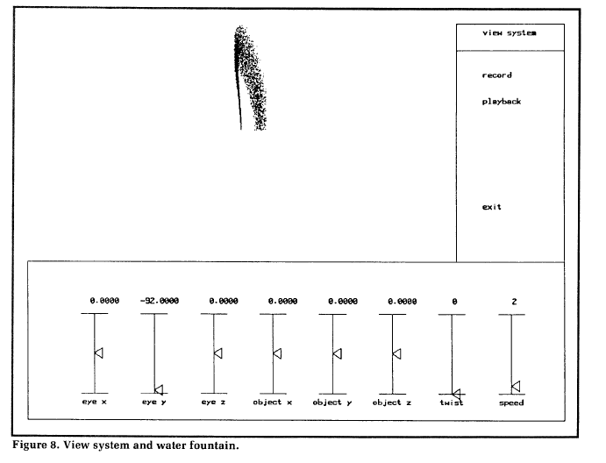
Key Parameter

Slide 41
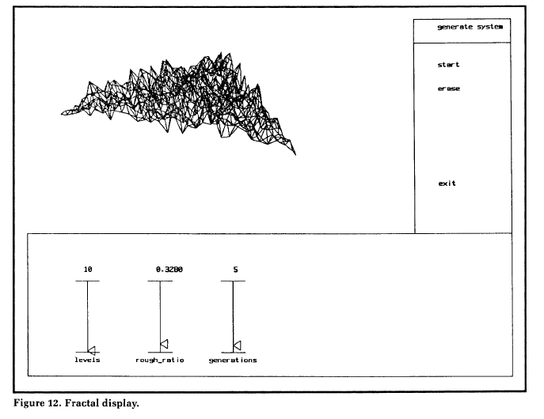
Key Parameter

Slide 42
Bones and Skin
Key pose and key parameter are often combined with bones and skin
If we have a complicated character, like a human we want the exterior surface of the model to move naturally, but we don’t want to control too many parameters
We can build a skeleton for the object, composed of rigid segments called bones, the bones are connected by transformation matrices
Can think of this as the real skeleton for a person, but with far fewer bones

Slide 43
Bones and Skin
The animator now controls the skeleton, since it is much simpler and we want the skin to follow the skeleton’s motion
For each point on the skin we define a transformation from the nearby bones to that point, a point may be controlled by multiple bones
This transformation is determined in a rest position
At the end of the initialization process we have a set of transformations and weights for each point on the surface
This can be done automatically or guided by the animator

Slide 44
Bones and Skin
When the skeleton moves, we combine the transformation for this motion with the previously computed transformation and its weight and we apply it to the point
If this is done correctly the object surface will follow the skeleton in a natural way
The process of setting up the skeleton and the handles for manipulating it is called rigging
This is a standard part of the animation process and supported by most animation software

Slide 45
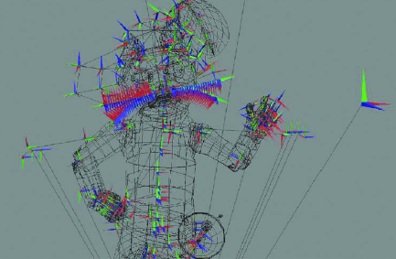
Rigging
Source: Art-Directed Technology: Anatomy of a Shrek2 Sequence, Siggraph 2004

Slide 46
Summary
Modern animation systems based on keys, interpolation, bones, etc., can be used to produce realistic motion in the hands of a good animator
Add in motion capture and you have all the tools required to produce feature length animations, standard industry practice
But, feature length animation is a very constrained environment, everything is preplanned, there are no surprises
If something moves unexpectedly the whole thing falls apart, the characters can’t respond to their environment

Slide 47
Summary
It is also very labour intensive, with a few characters this is okay, a background and two or three characters taking part in the action
But, if we want a crowd life becomes very hard, we need to animation each of the people in the crowd separately and make sure they don’t run into each other
This is at least O(n²) with the number of characters, not a very good situation

